Slide 1
builtin command in Linux Emacs vs. Vim: Run Linux Commands in the Background

Slide 2
builtin command in Linux
builtin command is used to run a shell builtin, passing it arguments(args), and also to get the exit status. The main use of this command is to define a shell function having the same name as the shell builtin by keeping the functionality of the builtin within the function.

Slide 3
Syntax:
builtin [shell-builtin [arg ..]]

Slide 4
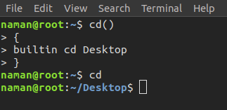
Example:
Here, we are creating a function to replace the ‘cd’ command. When you will use cd() function it will change the directory to the desktop directly.

Slide 5
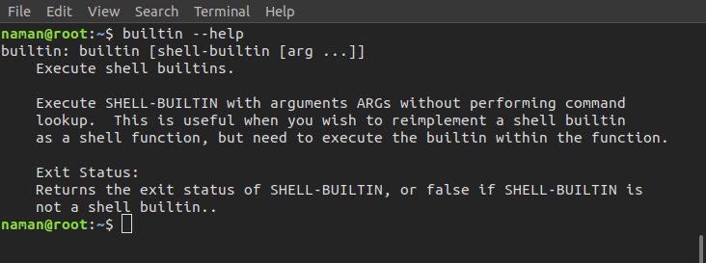
builtin –help Command: It displays help information.

Slide 6
`
Right Conduct | Peace | Truth | Love | Non -Violence
Manners | Patience | Truthfulness | Kindness | Consideration
Health Awareness | Concentration | Creativity | Friendship | Cooperation
Helpfulness | Positivity | Honesty | Forgiveness | Global Stewardship
Responsibility | Self Acceptance | Determination | Generosity | Loyalty
Independence | Self Discipline | Fairness | Compassion | Active Citizenship
Perseverance | Thankfulness | Trust | Tolerance | Justice
Courage | Contentment | Reflection | Service | Respect

Slide 7


Slide 8


Slide 9
Run Linux Commands in the Background

Slide 10
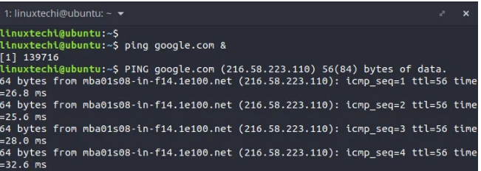
Running shell command in background using (&) sign
To run a command or a script to the background, terminate it with an ampersand sign (&) at the end as shown.
$ command &

Slide 11
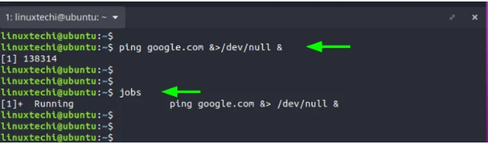
A better approach is to redirect the command to /dev/null and later append the ampersand sign at the end as shown
$ command &>/dev/null &

Slide 12
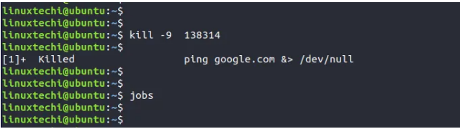
To terminate the background process, run the kill command followed by the PID of the process as follows. The -9 option terminates the process immediately.
$ kill -9 138314

Slide 13
Running shell command or script in background using nohup command
Another way you can run a command in the background is using the nohup command. The nohup command, short for no hang up, is a command that keeps a process running even after exiting the shell.
It does this by blocking the processes from receiving a SIGHUP (Signal Hang UP) signal which is a signal that is typically sent to a process when it exits the terminal.
To send a command or script in the background and keep it running, use the syntax:
$ nohup command &>/dev/null &
$ nohup shell-script.sh &>/dev/null &

Slide 14
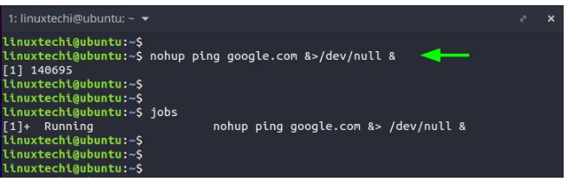
For example,
$ nohup ping google.com &>/dev/null &
Again, you can verify that the command is running in the background using the command:
$ jobs

